Slide 1

Phishing Awareness Training Module (Enhanced Version)
Welcome to this essential training module designed to empower you with the knowledge and tools to recognize and defend against sophisticated phishing attacks. In today’s interconnected world, cyber threats are ever-present, and your vigilance is our strongest defense.

Slide 2
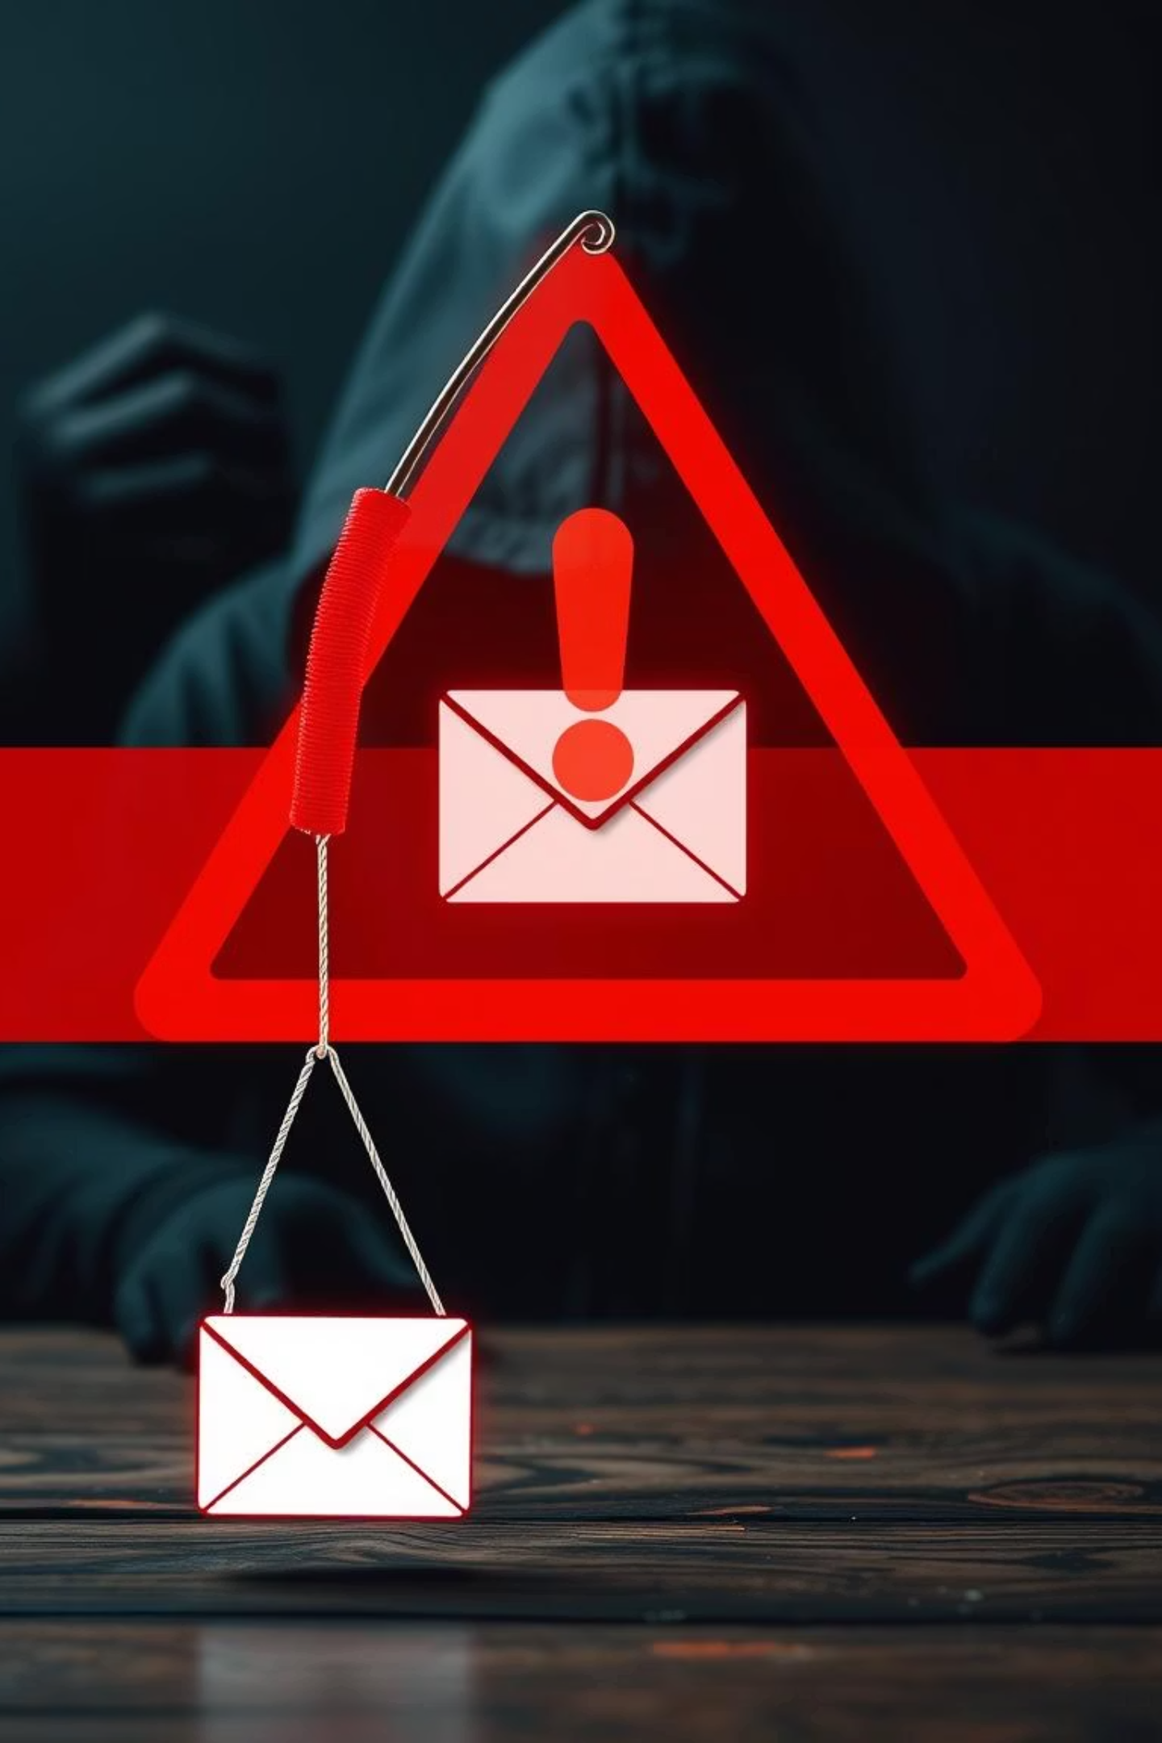
Phishing Awareness: Spot It Before You’re Caught
This module will guide you through the intricacies of phishing, from its definition and various forms to practical steps for identifying and reporting suspicious activities. By the end of this session, you will be better equipped to protect yourself and our organization from cyber threats.

Slide 3

What is Phishing?
Definition
Objective
Phishing is a cybercrime where attackers impersonate trusted entities (e.g., banks, IT support) via email, text, or phone calls to trick individuals into revealing sensitive information like login credentials, financial details, or personal data. These deceptive communications often mimic legitimate sources to gain your trust.
The primary goal of a phishing attack is to illegally obtain sensitive information. Attackers aim to gain unauthorized access to accounts, financial assets, or internal company networks. This access can then be used for fraud, data theft, or deploying malware.
Impact
Statistics
The consequences of falling victim to phishing can be severe, ranging from personal financial loss and identity theft to widespread corporate data breaches and significant reputational damage. For organizations, a single successful phishing attack can lead to millions in losses.
According to the Verizon Data Breach Investigations Report (DBIR) 2024, an alarming statistic reveals that over 90% of all data breaches originated from phishing attacks. This highlights how critical it is for everyone to be aware and vigilant.

Slide 4
Types of Phishing Attacks
1
Email Phishing
This is the most common form, where attackers send broad, generic emails that appear to be from legitimate, well-known companies or services, often attempting to create a sense of urgency or alarm.
2
Spear Phishing
Highly targeted attacks where emails are personalized for specific individuals, leveraging publicly available information or details gleaned from social media to make the communication more convincing.
3
Whaling
An extremely specific form of spear phishing that targets high-profile executives like CFOs or CEOs, aiming to gain access to sensitive company data or authorize large financial transactions.
4
Smishing
Phishing attacks conducted via SMS messages (text messages), often containing malicious links that, when clicked, can install malware or redirect users to fake websites.
5
Vishing
Voice phishing, where attackers use phone calls to impersonate legitimate entities such as banks, government agencies, or tech support, to trick victims into revealing personal information.
6
Clone Phishing
Attackers create an exact replica of a legitimate, previously delivered email, then replace links or attachments with malicious versions. They might claim it's an "updated" version of the original.
7
Business Email Compromise (BEC)
Sophisticated scams involving the impersonation of a business partner or an internal colleague (e.g., a CEO) to trick employees into transferring funds or sensitive data.

Slide 5
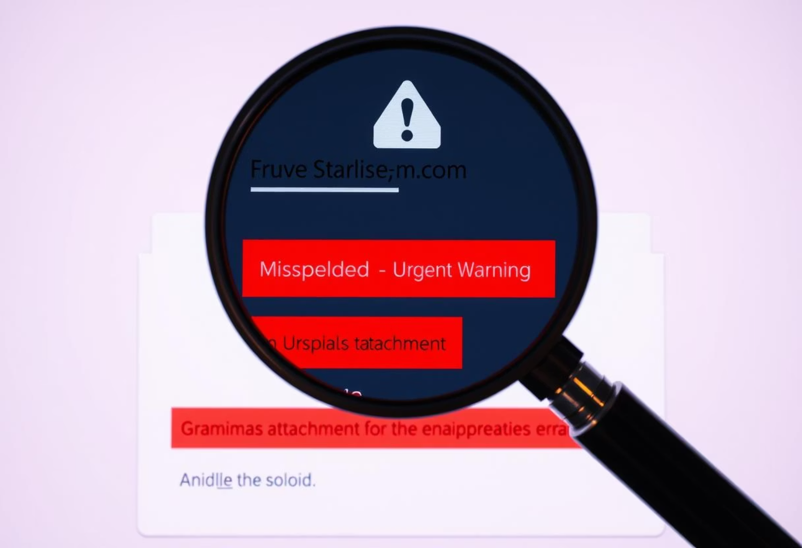
How to Recognize a Phishing Email
Inconsistencies in Sender Address
Always check the sender's full email address. Look for subtle misspellings or unusual domains, e.g., support@arnazon.com instead of @amazon.com.
Urgent or Threatening Language
Phishing emails often use high-pressure tactics to provoke immediate action, such as "Act now to avoid account suspension!" or "Your account will be locked."
Unexpected Links or Attachments
Be wary of unsolicited links or attachments, especially if they are executables (.exe) or compressed files (.zip). These can contain malware.
Poor Grammar or Odd Formatting
Legitimate organizations typically maintain high standards for their communications. Typos, grammatical errors, or inconsistent branding are major red flags.
Tip: Always hover over links to preview the destination URL before clicking. If the URL doesn't match the expected site, do not click it.
Unusual Requests
No reputable company will ask for your password, bank account details, or demand gift cards via email. Such requests are almost always indicators of a scam.

Slide 6
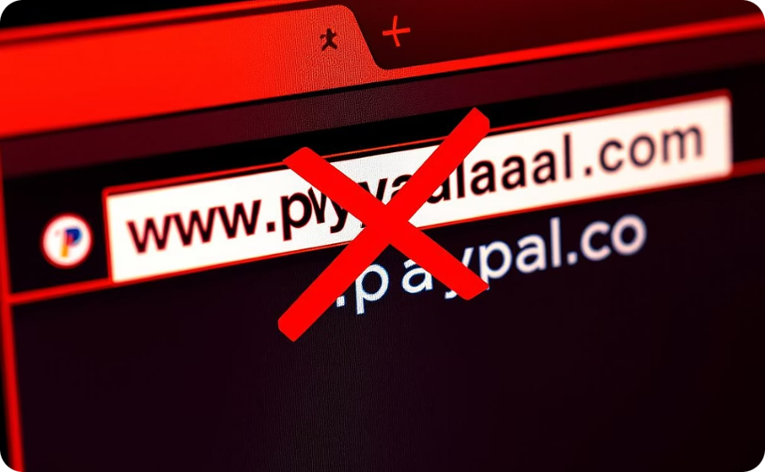
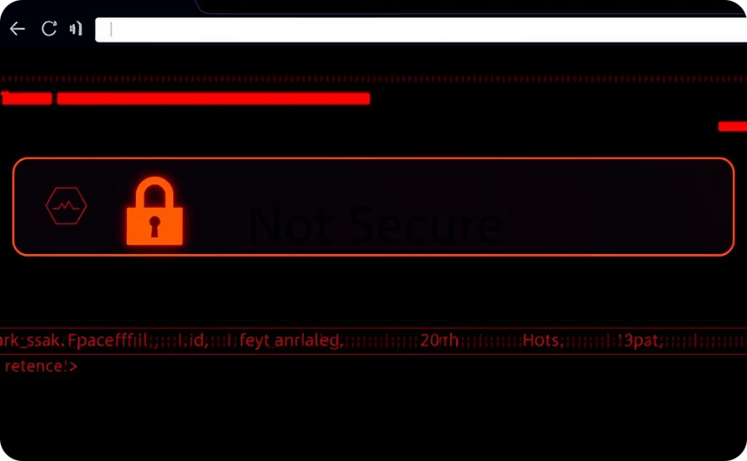
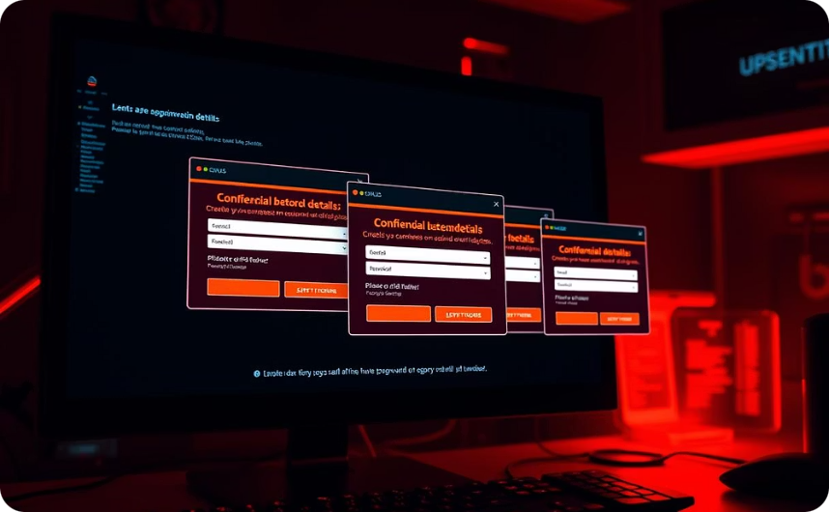
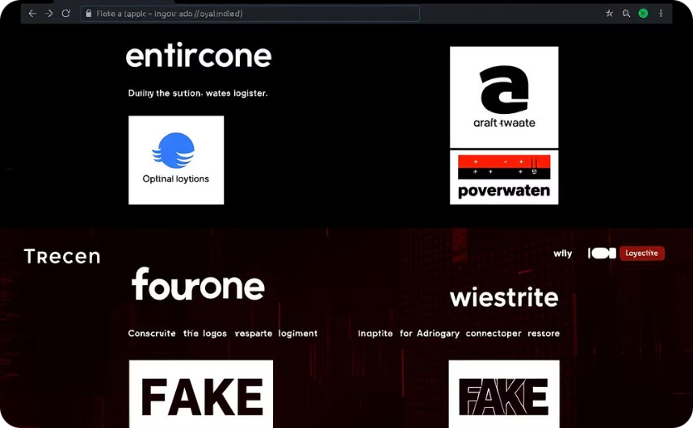

Spotting Fake Websites
URL Mismatch
No SSL Certificate
Pop-ups Requesting Confidential Details
Visual Anomalies and Poor Quality
The most telling sign: the URL in the address bar does not exactly match the legitimate organization's website. Be wary of subtle misspellings, added words, or unusual subdomains, such as www.paypalsecure-login.com.
Legitimate websites use SSL/TLS encryption, indicated by a padlock icon and "https://" in the URL. If these are absent, or if your browser shows a "Not Secure" warning, it's a critical red flag.
Be extremely cautious of unexpected pop-up windows on a website that demand sensitive information like passwords, bank details, or social security numbers. Legitimate sites rarely ask for this via pop-ups.
Fake websites often have low-resolution logos, inconsistent branding, odd fonts, or generally poor design. These visual inconsistencies are often signs of hastily created fraudulent sites.
Domain Age
Many phishing websites are newly registered domains. While not a definitive sign alone, a very recent registration date (which can be checked via WHOIS lookup) combined with other red flags increases suspicion.

Slide 7





Social Engineering Tactics
Social engineering is the psychological manipulation of people into performing actions or divulging confidential information. It's often the prelude to or an integral part of phishing attacks.
Impersonation
Attackers pretend to be someone trustworthy, such as a coworker, a senior executive (like the CEO), or IT support staff, to gain your confidence and access.
Pretexting
This involves creating a false scenario or narrative to trick the victim into providing information, e.g., "We need this information for audit compliance" or "Your account has been compromised."
Baiting
Attackers offer a tempting, fake reward to lure victims, such as "free" movies, music, or software downloads, which are actually malware or links to malicious sites.
Quid Pro Quo
A promise of a service or benefit in exchange for information. For instance, offering "IT support" for a supposed system issue if you provide your login credentials.
Tailgating/Piggybacking
A physical social engineering tactic where an unauthorized person gains access to a restricted area by following closely behind someone with legitimate access.
Real Tip: Always trust your instincts. If something feels "off" – a request is unusual, or a situation seems too good to be true – investigate it thoroughly or report it to IT security.

Slide 8
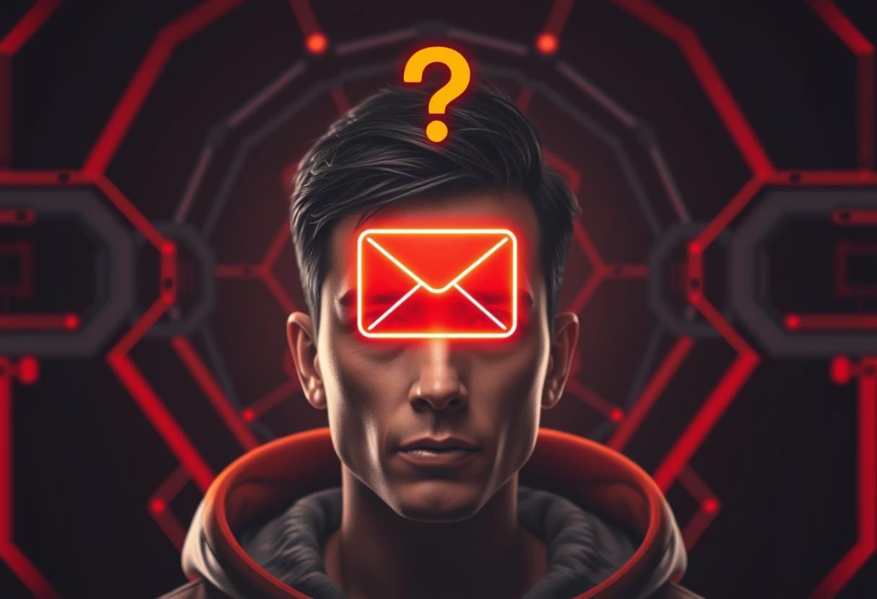
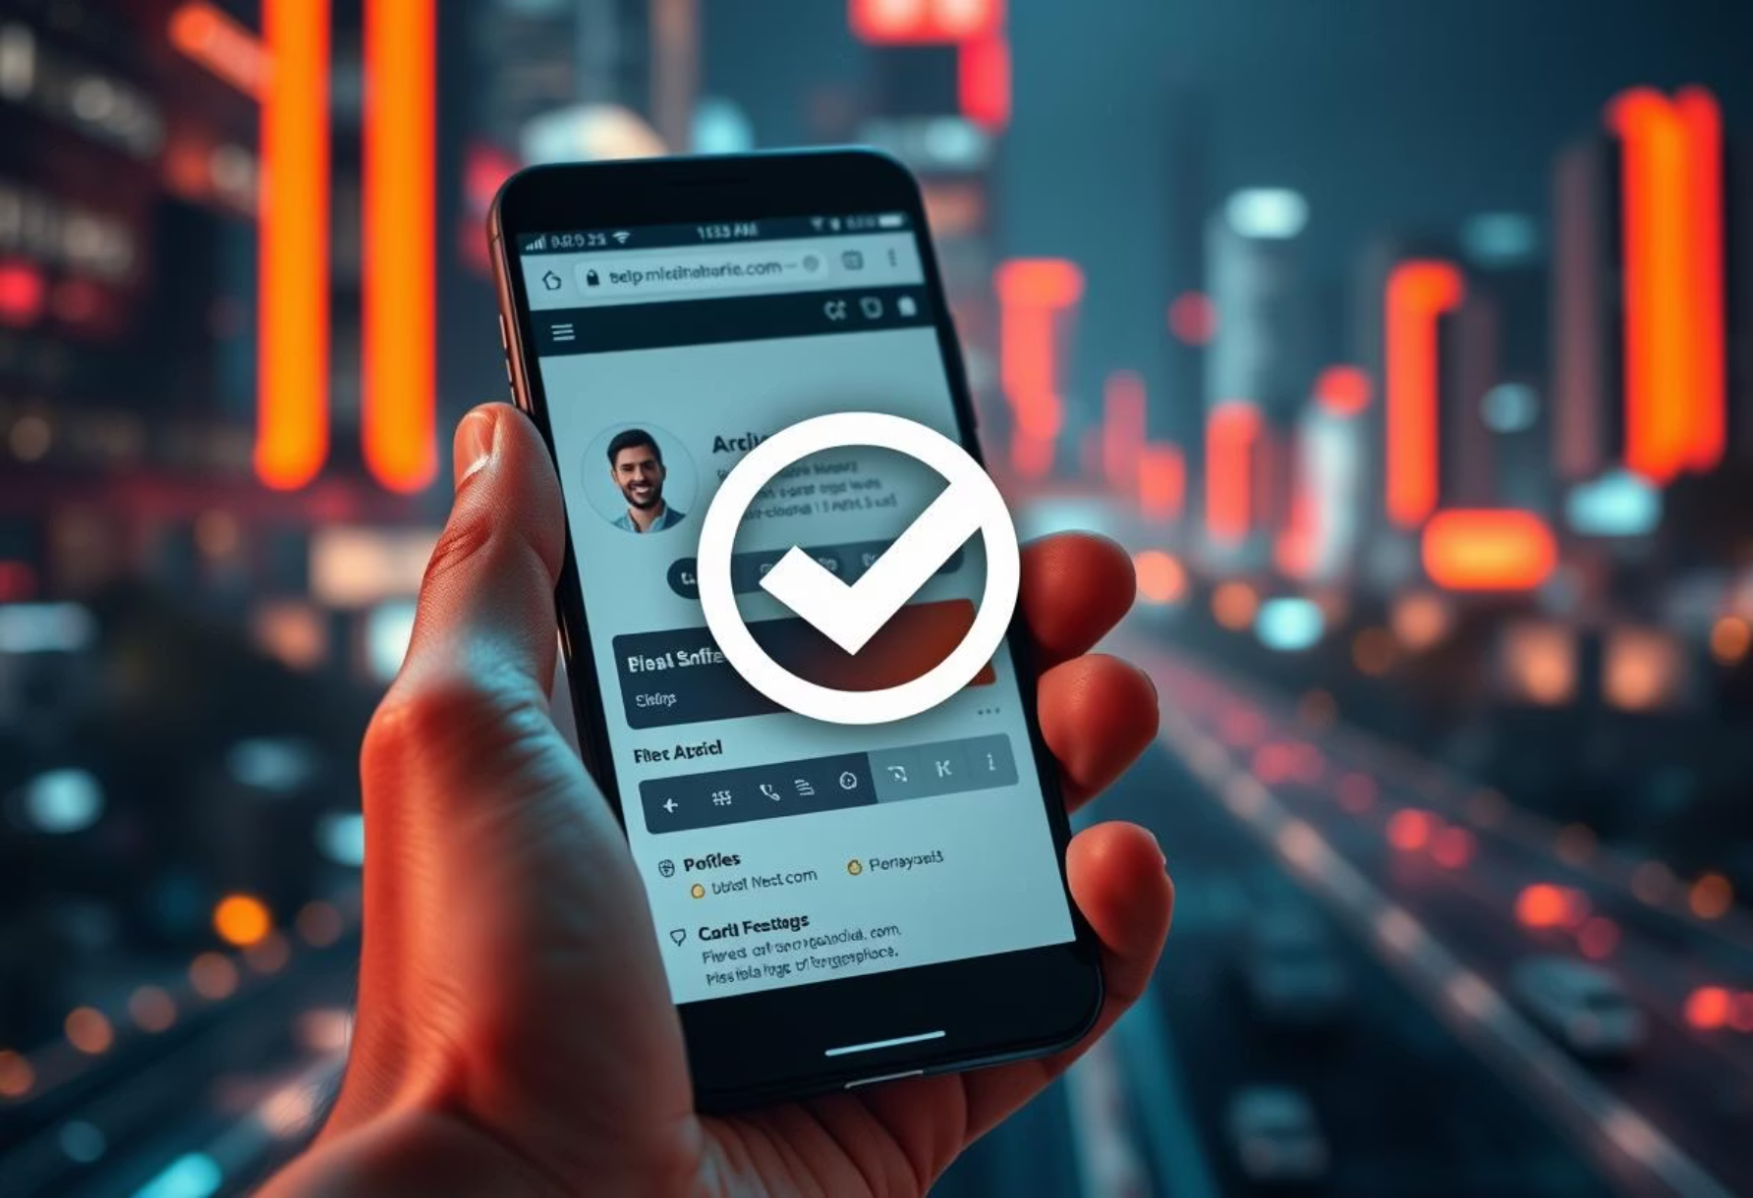

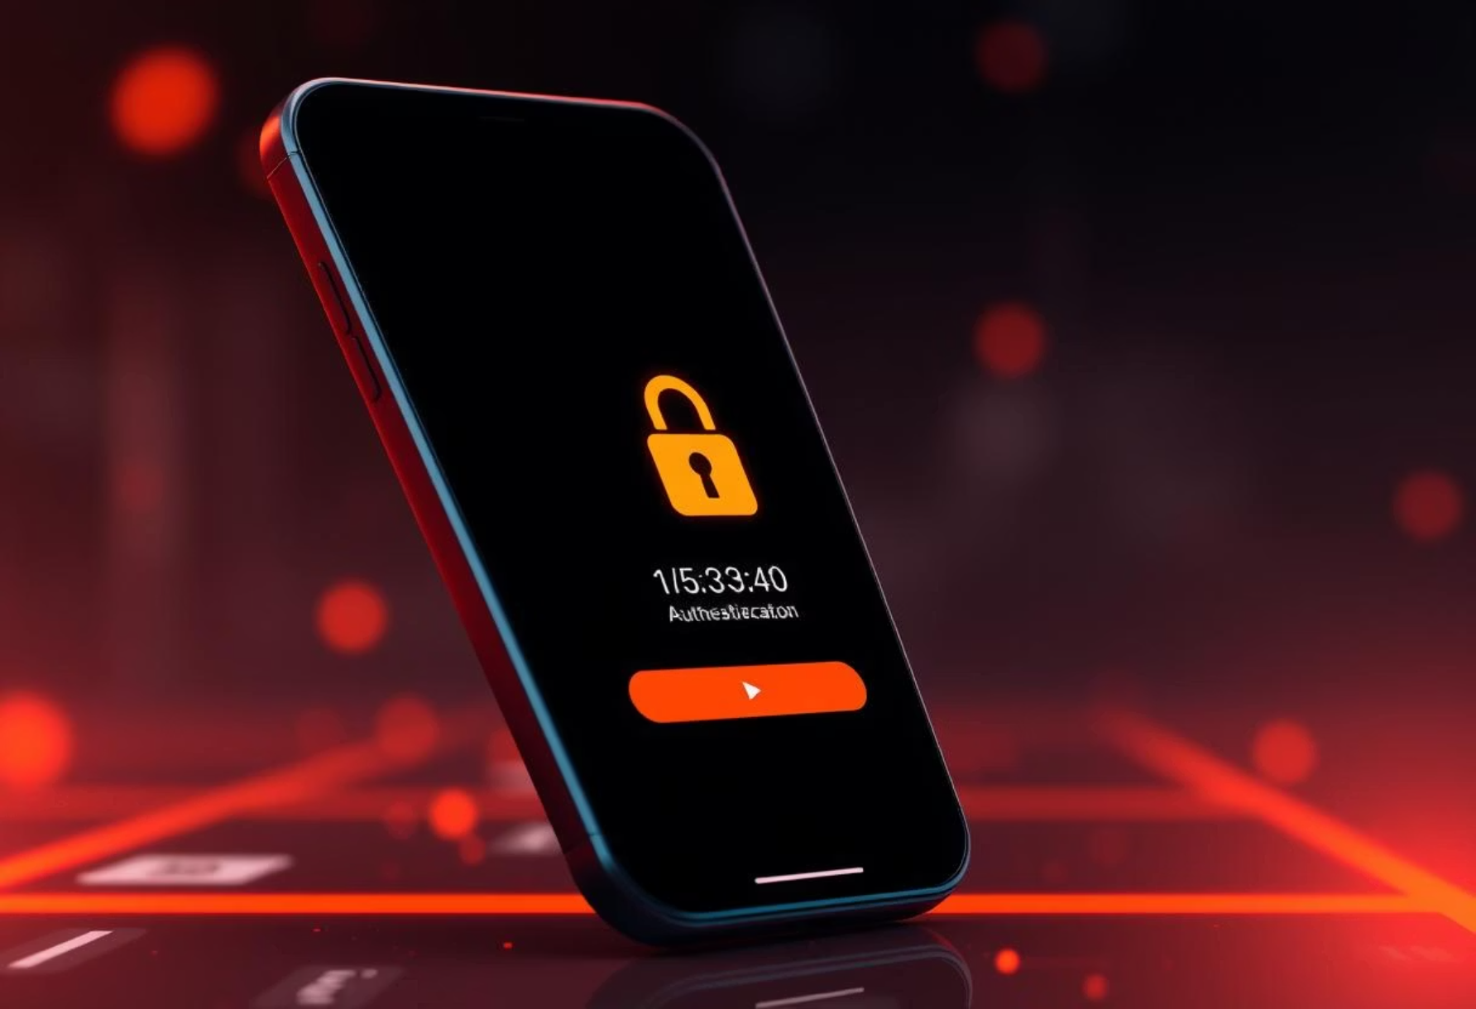
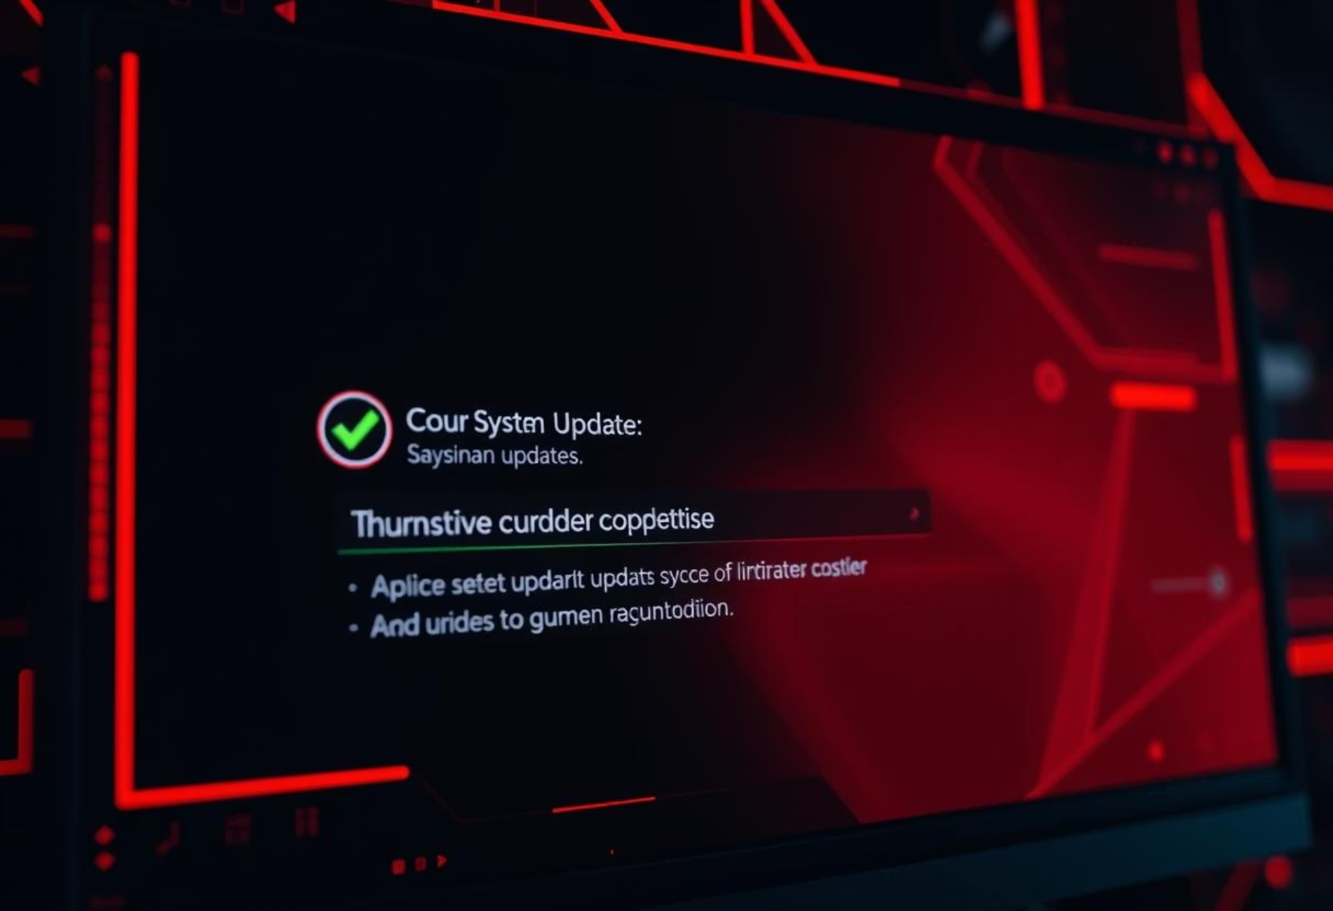

Best Practices to Stay Safe
Be Skeptical
Verify the Source
Treat every unsolicited message, especially those requesting personal information or immediate action, with extreme caution. Assume it might be a phishing attempt until verified.
If unsure about a message, do not use the contact information provided in the suspicious communication. Instead, independently find official contact details (e.g., from the company's official website) and verify.
Use Strong, Unique Passwords
Enable Multi-Factor Authentication (MFA)
Implement complex passwords that combine letters, numbers, and symbols. Use a password manager to generate and store unique passwords for each account, minimizing risk if one is compromised.
MFA adds a critical layer of security by requiring a second form of verification (like a code from your phone) in addition to your password. This makes it much harder for attackers to gain access even if they have your password.
Regularly Update Systems and Software
Educate Yourself and Others
Keep all operating systems, web browsers, and applications up to date. Software patches often fix known vulnerabilities that attackers exploit, significantly enhancing your security posture.
Ongoing training and awareness are your best defenses. Stay informed about new phishing tactics, share information with colleagues, and participate in regular security awareness programs.

Slide 9
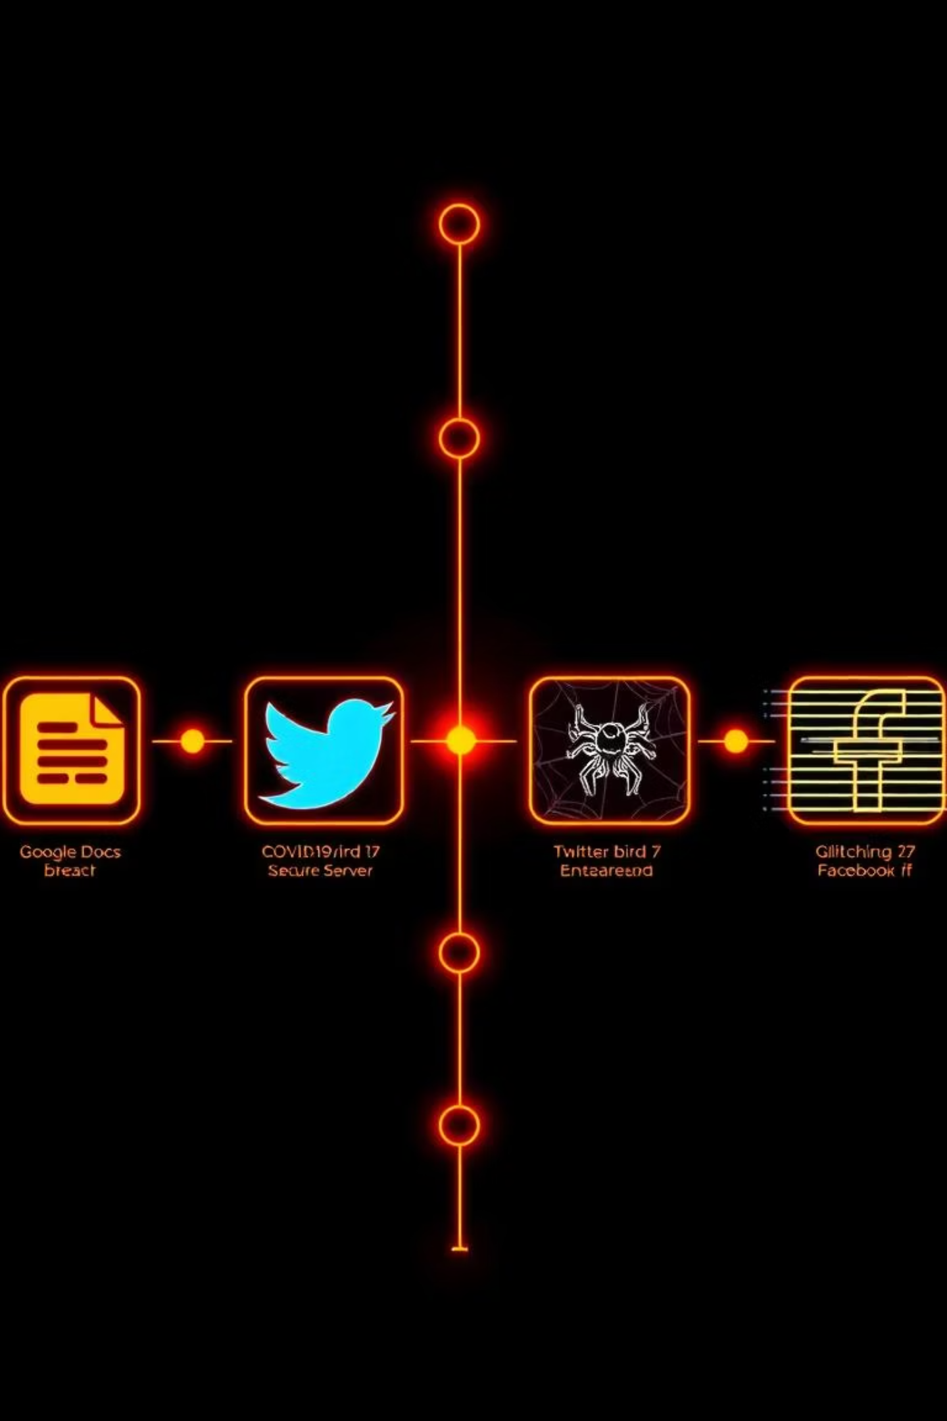




Real-World Examples
Phishing attacks are constantly evolving, becoming more sophisticated and harder to detect. Here are a few notable real-world examples that highlight the ingenuity of attackers and the potential impact.
Google Docs Phishing (2017)
Attackers sent deceptive Google Docs invitation emails through a third-party application that looked legitimate. Clicking the link led to granting permissions to a malicious app, compromising user accounts.
COVID-19 Stimulus Scams
During the pandemic, numerous phishing scams emerged, with emails and texts promising "COVID-19 stimulus payments" or "relief funds" to trick victims into providing bank account information.
Twitter Hack (2020)
A major social engineering attack led to the compromise of high-profile Twitter accounts, including those of Elon Musk and Apple, used to promote a Bitcoin scam. This showed how even large organizations are vulnerable.
Facebook Login Scam
Users were redirected to meticulously crafted fake Facebook login pages that prompted "re-authentication." These pages mimicked the real site perfectly, designed solely to steal user credentials.
Lesson: These examples underscore that even individuals who are tech-savvy or vigilant can fall victim to sophisticated phishing campaigns. Continuous awareness and adherence to security best practices are crucial.

